Slide 1
Indian Agriculture in MesoAmerica
AG 101 – Ag & The Modern World

Slide 2
Before European Contact…
7000BC
  Mesoamerican farmers engaged in rudimentary agriculture: seeding, cultivating, harvesting, domestication of various plants
Who were the Mesoamericans?
  Indians of Central America & Mexico
  Mayans & Aztec

Slide 3
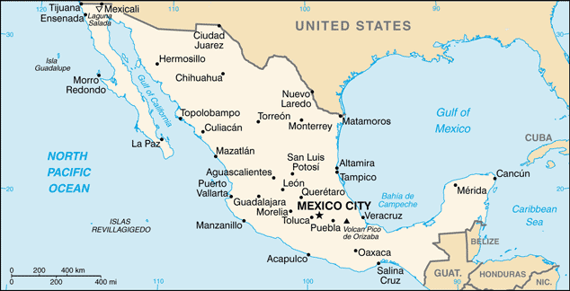
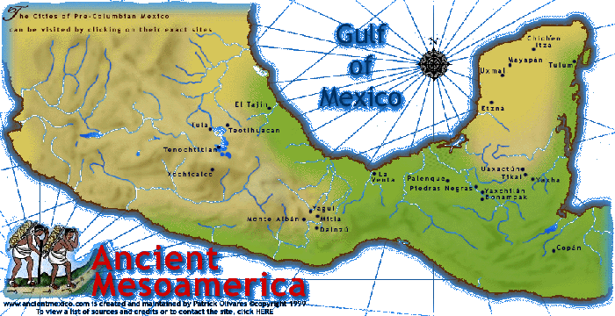
Present day Southern Mexico, Belize, Guatemala, Honduras
Tehuacan Valley;
Aztec Empire
Maya

Slide 4
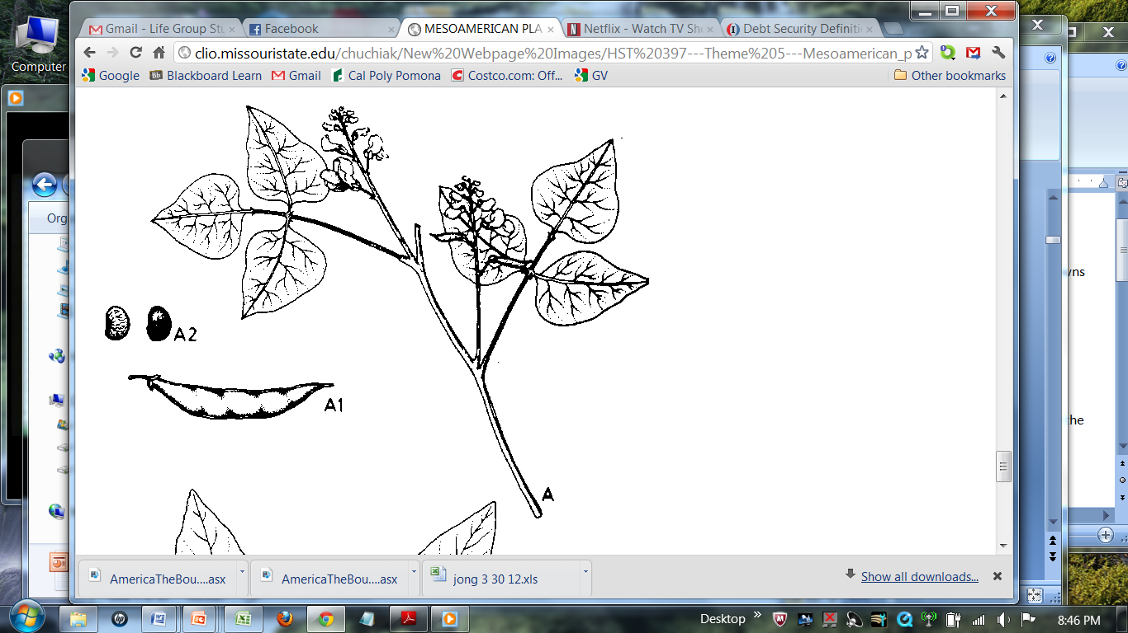
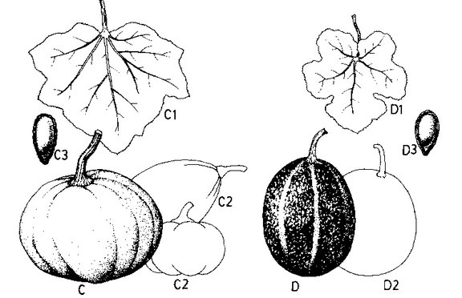
7000bc-5000bc
Depended on nomadic subsistence living
Slowly began cultivation of plants
  Clear land, plant, harvest
  Agriculture (purposeful growing) very small portion of diet
  Crops: pumpkins, gourds, beans
Notes:
Indians cleared unwanted land, planted seeds, harvested --> led to the birth of agriculture in the Western Hemisphere.
However Agriculture still made up a very small portion of the diet. Indians still depended on hunting & gathering for substance living.
The early crops grown included pumpkings, gourds, and beans.

Slide 5
5000bc-3400bc
Tehuacan Valley, later dominated by Aztec
  Center of agricultural development
  Soil & water availability ideal
  Manipulation of environment
  Increase in number of farmers
  Gradual shift to dependence on plants, seeds & fruit
  Domestication of corn
  Other crops: avocado, chili pepper, other bean varieties
  Spring & summer: planting
  Autumn & winter: hunting & gathering
Notes:
Soil fertilize in this region, water available from rain fall and a low water table.
Shift towards settlement continued to be slow during this time frame - over 2000 yrs.
Soil fertile, water from run-offs, low water table (for wells later on)
Durning this time, Indians learned to manipulate their environment by encouraging growth of certain plants, by removing competitive weeds, by clearing the land, and by planting & harvesting.
Cultivation of plants became more important as more Indian farmers

Slide 6
On the Path to Settlement
3400bc-2300bc
  Villages developed
  Surplus of vegetable crops
  Rudimentary seed selection led to bigger yields
2300bc-500bc
  Signs of sedentary lifestyle led to:
    Intense cultivation, farming on larger fields
    Crops: lima beans, squash, tobacco, cotton, sunflower, tomatoes
Notes:
Surplus of food that would sustain them through the colder season, thus leading to reduced hunting & gathering activities

Slide 7
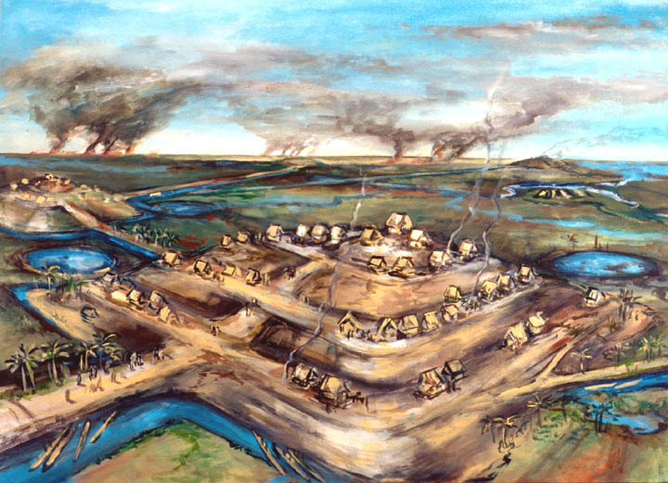
Mayan People
Developed complex agricultural economy in the rain forest by 1200BC
By 500BC agriculture became primary food source
Agricultural practice of
“slash & burn” method
  Shallow topsoil lead to
  quick nutrient depletion
  Practiced soil rotation,
  some lasting several years
Notes:
Muck from drain canals were placed in raised stone terraces - soil was fertile & moist allowing for excellent plant growth.

Slide 8
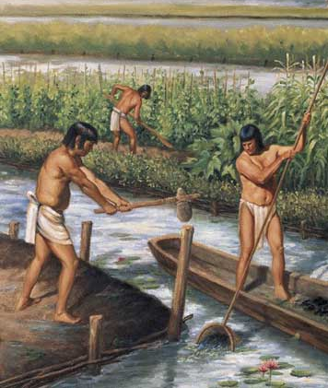
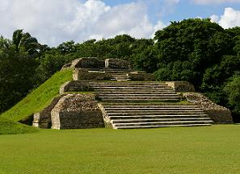
Mayan Agriculture
Mayans:
  The Maya cultivated swampy land using a system of raised fields and canals
    low maintenance and extremely productive

Slide 9
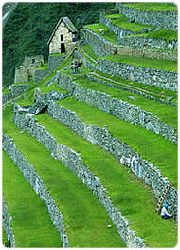
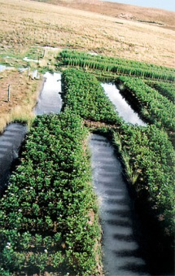
Mayan People
Raised swamplands for agriculture
  Dug drain canals & built raised stone terraces
Developed extensive hillside terraces
Notes:
Muck from drain canals were placed in raised stone terraces - soil was fertile & moist allowing for excellent plant growth.

Slide 10
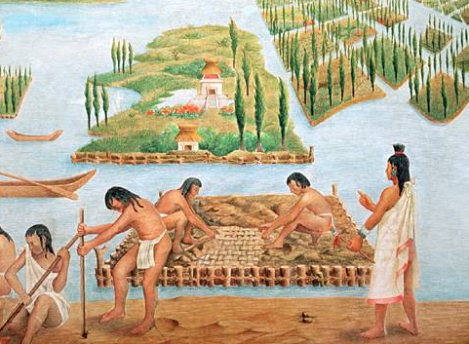
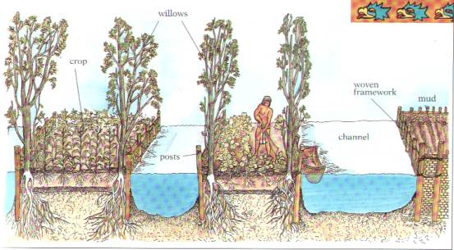
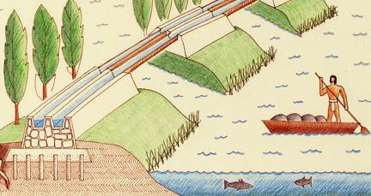
Aztec, Incan & Mayan Cultures
Farmed using hand tools
Cultivated maize, beans, squash,
as well as most native crops
Aztecs:
  Experts in irrigation and reclamation of swampland

Slide 11
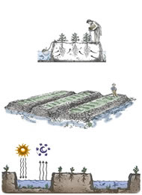
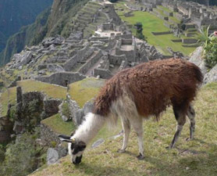
Incan Agriculture
Incans:
  Society based on Agriculture
  Cultivated on Terraces
  Used hand tools
  Used Llamas as animal
  labor to haul

Slide 12
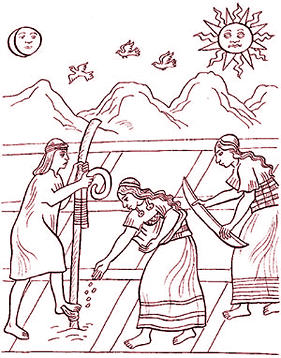
Mesoamerican Farmers
500BC-1600AD
Full time farmers
  Nutritional staples: squash, bean, corn (primarily a vegetarian diet)
  Skillful plant breeders: increased yield (i.e. corn)
  Manual labor with stone tools

Slide 13
Mesoamerican Farmers
500bc-1600ad
Developed sophisticated land use systems
  Basis for highly productive agricultural economy
  Sophisticated irrigation systems: dams, channels, underground wells)

Slide 14
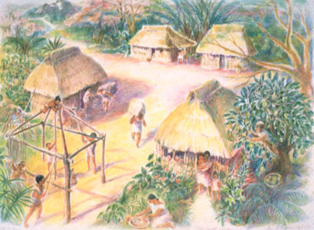
Mesoamerican Farmers
500BC-1600AD
Establishment of agrarian-based civilization
  Permanent villages, distinctive culture, trade, government, textiles (animal wool)

Slide 15
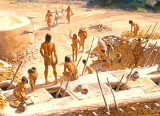
North American Native Tribes
Pueblo tribes of Southwest had adobe homes and built complex irrigation systems
Though not as advanced as Aztec, Maya or Inca civilizations

